Slide 1


Integrated Magnetic Component for Innovative Power Converter
Benoit Krafft / Bruno Cogitore / Kokouvi Etse
ESA / SPCD 2026
15th October 2026
Notes:
version longue (slide par application

Slide 2
Outline
Introduction
EXXELIA R&D: addressing emerging trends in power electronics
Integrated Magnetics : core concepts & benefits
IMC for high frequency SMPS: core design & loss profiles
Thermal Optimization : finite element modelling & analysis
Concept Validation : integrated vs discrete magnetics
Four-year development progress
Field-proven integrated magnetic components including space applications
Conclusion

Slide 3
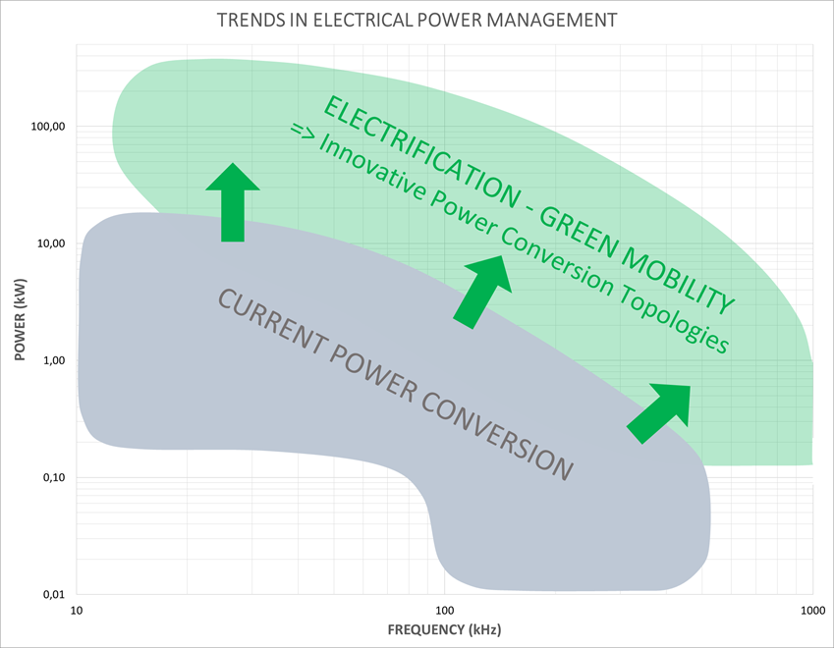
POWER ELECTRONICS TRENDS
Reduce
carbon footprint
Become lighter and more energy efficient
Replace hydraulic and pneumatic systems with electric systems
Power Electronics challenges
Higher Voltage
Higher Frequency
Bidirectional
Higher Power Density
Active components :
Wide Gap Semiconductors
(Gan / Sic)
More electric launchers/satellites :
➔ More functions
➔ More power
Topologies :
PSFB / DAB/MAB / resonant LLC/ interleaved converters
ANSWER
Magnetic components :
EXXELIA develops Integrated Magnetic Components (IMC)
Notes:
Pillar 2 “KILL the DEAD WEIGHT”

Slide 4
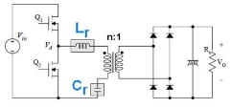
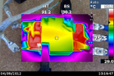
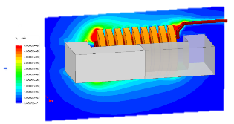
EXXELIA R&D: Addressing emerging trends in power electronics
PILLAR S1
INTEGRATED MAGNETIC COMPONENTS
One component, multiple functions
PILLAR S2
THERMAL
OPTIMIZATION
→ The right design margin
PILLAR S3
RELIABILITY OF
HIGH VOLTAGE COMPONENTS
→ Master high voltages
Smart magnetic
Subsystem supporting innovative architectures
Consistent leakage inductance
Reduced winding self capacitance
Size and weight reduction
The smallest high reliability component for specified rating
Accurate losses calculation
Thermal modeling
The smallest high reliability component for specified high operating voltages
Partial discharge mitigation
Building block development
Notes:
Pillar 2 “KILL the DEAD WEIGHT”

Slide 5
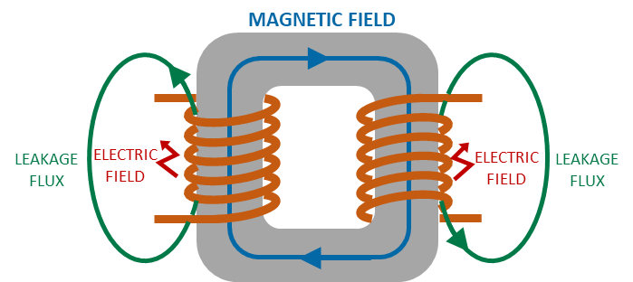
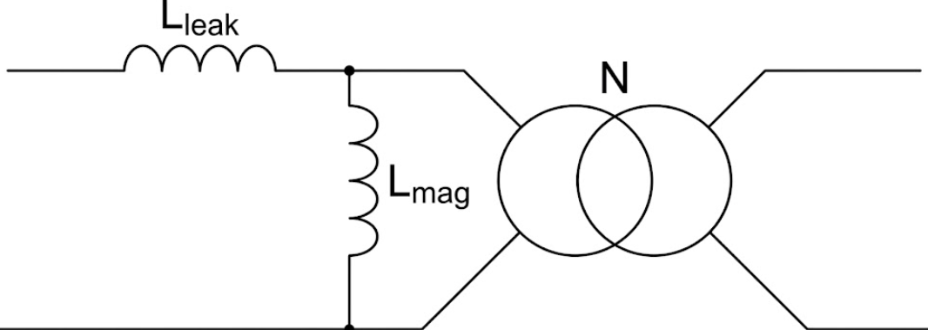
INTEGRATED MAGNETICS : Core concepts & Benefits
→ Two functions (Transformer + Inductor) with One Single magnetic circuit
Main transformer parasitic effect : Leakage inductance
  Value often too low to be used
  Significant uncontrolled variations in series production
  Converter strongly affected especially at high frequency
Control these effects to avoid settings and compensation devices
Leverage these effects to offer additional functions to the component
Benefits
Fit innovative architecture requirements (High Frequency, Soft Switching – DAB / LLC / PSFB…)
More compact (Shared iron core and windings)
Simplifies PCB routing and assembly complexity
Higher efficiency
Better reliability (Reduced component count)
Cost effective
Single Magnetic component
Notes:
Positionné ds custom design dans environnement contraint
It meets the more electric needs
Face to Face R&D des le depart
Non obsolescence policy
Obsolescence
early stage , early beginning of the project put R&D in contact

Slide 6
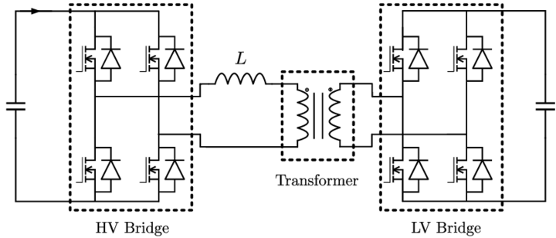
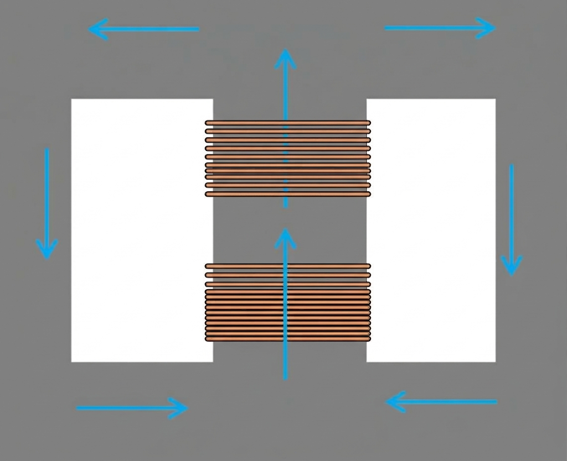
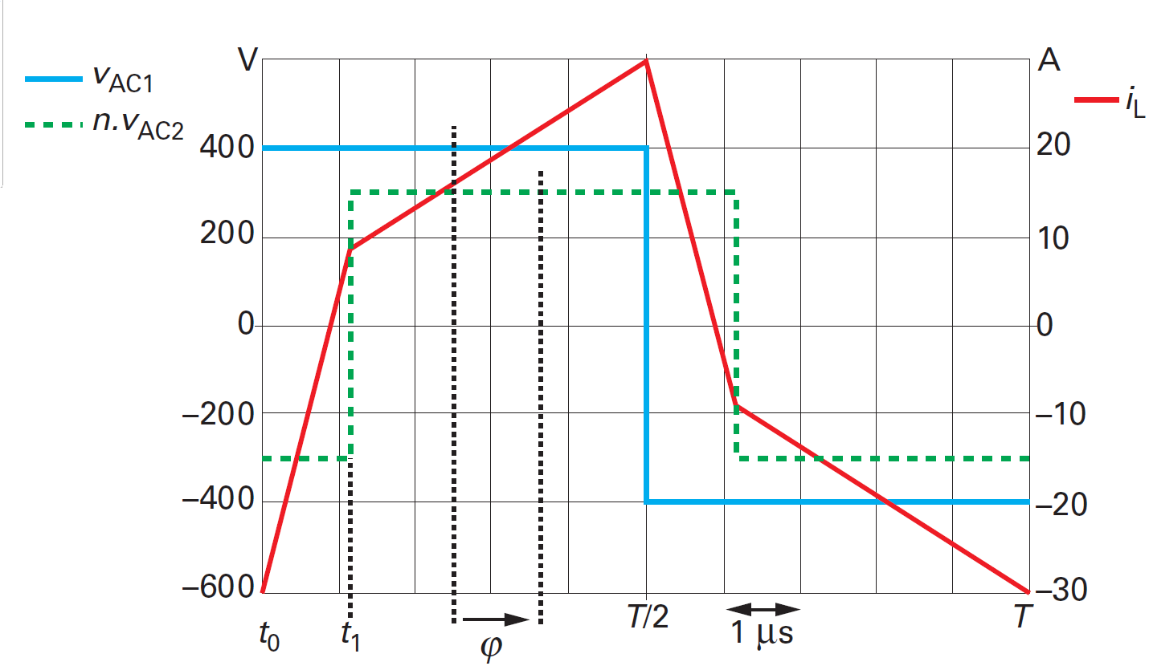
IMC for High Frequency SMPS: Core Design & Loss Profiles
Case of a Dual Active Bridge
Classical IMC Transformer structure
IMC
Magnetizing flux
Leakage flux
P
S
EXXELIA Engineering Capabilities
Advanced Flux Management: Core designed to handle both magnetizing and large leakage fluxes, with loss calculations incorporating harmonic effects.
Custom Iron Core Geometries: Tailored designs to target specific leakage inductances while strictly minimizing both core (iron) and winding (copper) losses.
Unique Loss Profile: In contrast to conventional transformers, the integrated leakage path generates core losses in both open-circuit and short-circuit states.

Slide 7
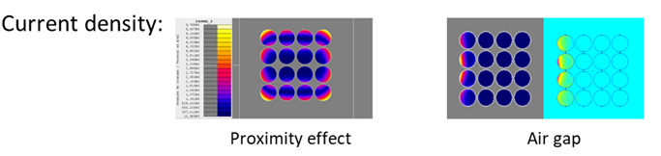
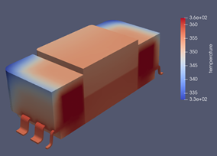
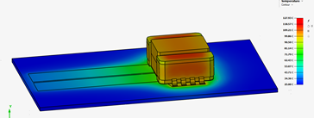
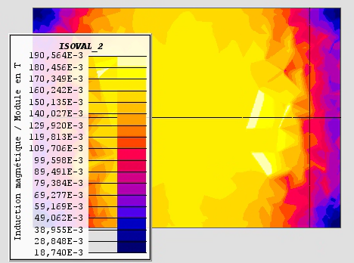
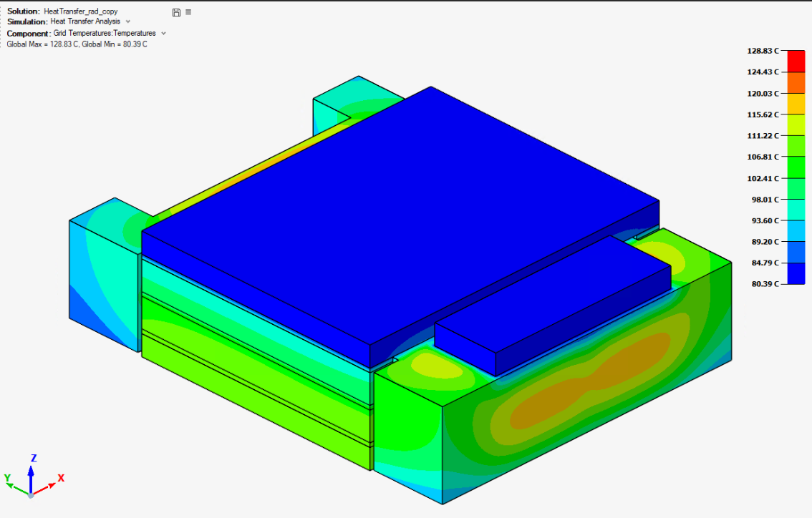
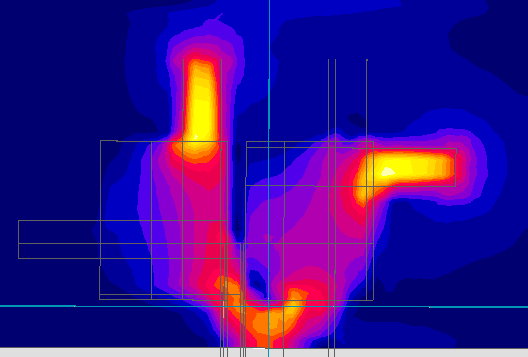
THERMAL OPTIMIZATION : Finite Element Modelling & Analysis
  Ferrite core losses
  Flux density distribution evaluation
  Accurate Core Loss Evaluation: Computed from the spatial flux density distribution inside the core using Altair Flux™ post-processing.
  Copper losses
  Current density analysis
  3D Modelling and Analysis of Component Temperature Rise in Operating Environments
Skin + Proximity effects
Fringing effect
Advanced mapping of current distribution & losses across termination and wiring areas
Selection of core material / Operating Flux density
Type of winding / Terminal type / Wiring technology
Product Finishing & Encapsulation: Advanced potting, vacuum impregnation, and custom housing options.

Slide 8
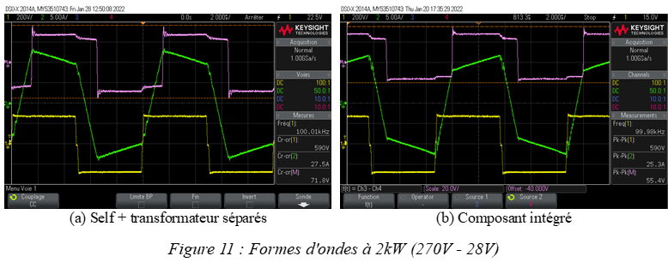
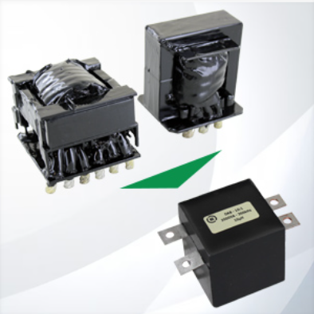
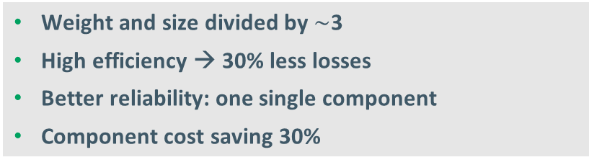
CONCEPT VALIDATION : Integrated Vs Discrete Magnetics
IMC For DAB Converter
2 kVA / 12µH / 320kHz / Vin : 270V / Vout 28V
Inductor + Transformer : Discrete components /
Inductor + Transformer : Integrated Magnetics
Experimental waveforms
: P voltage 270V
: S voltage 28V
: P current
Weight and size divided by $\sim$3
High efficiency → 30% less losses
Better reliability: one single component
Component cost saving 30%

Slide 9
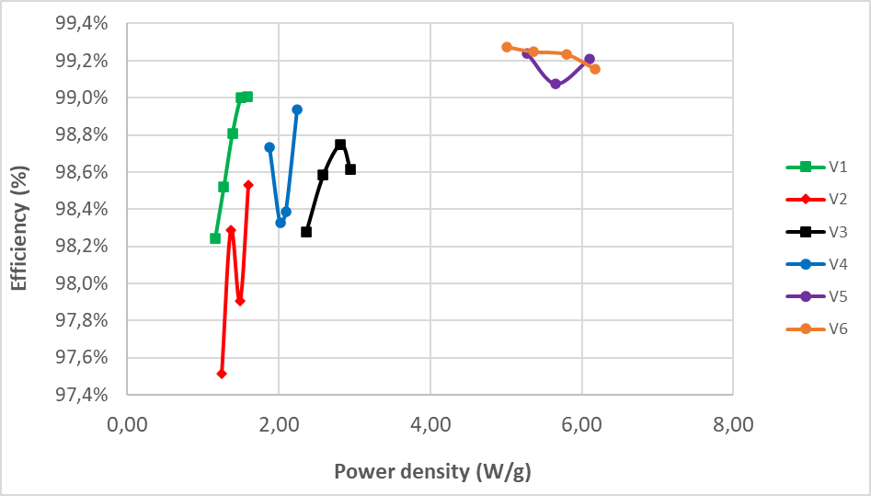
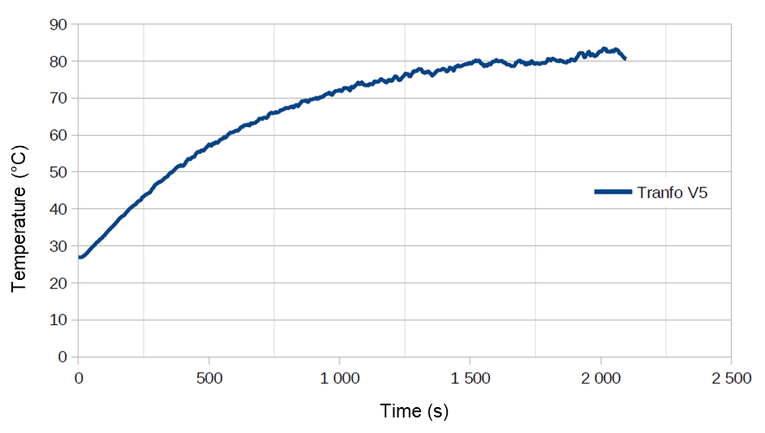
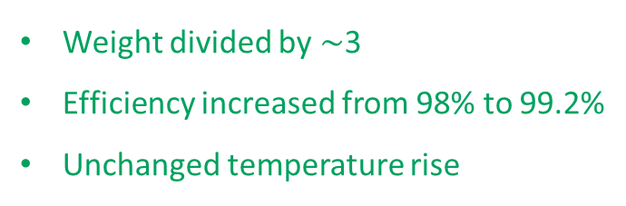
FOUR-YEAR DEVELOPMENT PROGRESS
IMC Specifications
  2 kVA / 12 µH / 320kHz / Vin : 270V / Vout 28V
Design Evolution
Temperature rise under natural convection
2020
2024
Weight divided by $\sim$3
Efficiency increased from 98% to 99.2%
Unchanged temperature rise

Slide 10
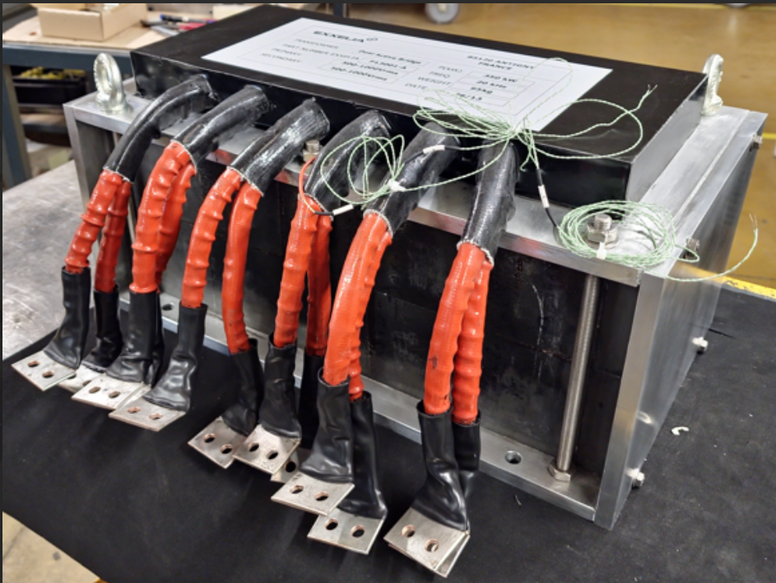
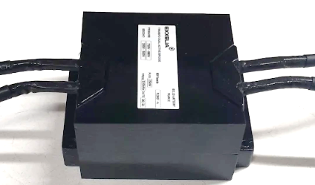
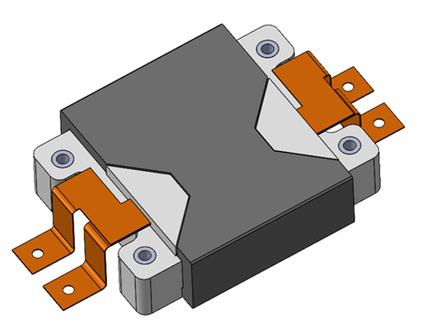
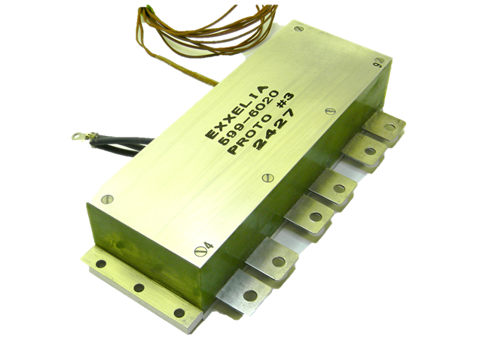
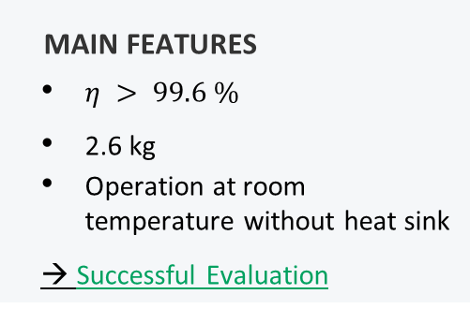
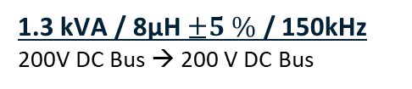

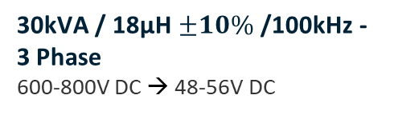
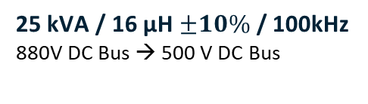
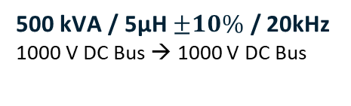


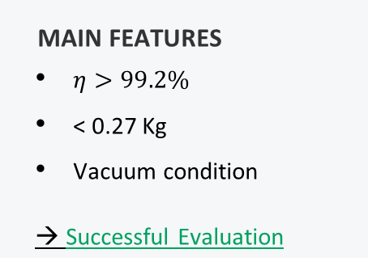
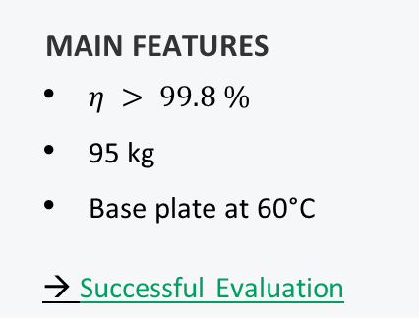
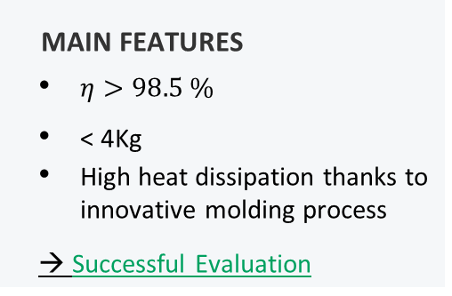

FIELD-PROVEN INTEGRATED MAGNETIC COMPONENTS
Integrated Magnetics Component for Bidirectional Power Supply (Dual Active Bridge)
  500 kVA / 5µH $±10\%$ / 20kHz
  1000 V DC Bus → 1000 V DC Bus
  25 kVA / 16 µH $±10\%$/ 100kHz
  880V DC Bus → 500 V DC Bus
  30kVA / 18µH $±10\%$ /100kHz - 3 Phase
  600-800V DC → 48-56V DC
  1.3 kVA / 8µH $±5 \%$ / 150kHz
  200V DC Bus → 200 V DC Bus
  10.4 x 10.2 x 6 cm3 $⇒$39.3 VA/cm³
  8,4 x 5,2 x 25 cm3 $⇒$27,5VA/cm³
  6.2 x 5.2 x 2 cm3 $⇒$20.2 VA/cm³
  50 x 28 x 24 cm3 $⇒$14.9 VA/cm³
MAIN FEATURES
$η > 99.8 \%$
95 kg
Base plate at 60°C
→ Successful Evaluation
MAIN FEATURES
$η > 99.6 \%$
2.6 kg
Operation at room temperature without heat sink
→ Successful Evaluation
MAIN FEATURES
$η>98.5 \%$
< 4Kg
High heat dissipation thanks to innovative molding process
→ Successful Evaluation
MAIN FEATURES
$η>99.2\%$
< 0.27 Kg
Vacuum condition
→ Successful Evaluation
Notes:
Positionné ds custom design dans environnement contraint
It meets the more electric needs
Face to Face R&D des le depart
Non obsolescence policy
Obsolescence
early stage , early beginning of the project put R&D in contact

Slide 11
CONCLUSION
Exxelia Engineering capabilities
  Design of IMC for innovative power converters topologies (DAB, LLC, PSFB…)
  Design IMC for SMPS from 100W up to 500 kW + Few nH to several hundreds of µH / Few kHz up to 500 kHz
  Achieve high efficiency & power density IMC > 30 W/cm3
Perspectives
  Development of coreless IMCs for frequencies between 500kHz and 1MHz
  Control and use of parasitic capacitances for resonant power converters
  IMC including ZVS inductor and Output filtering inductor

Slide 12
Thank You
Benoit KRAFFT
Technical Manager • Exxelia Magnetics
Phone: +33 (0)3 82 59 17 32
Cell: +33 (0)6 35 22 53 79
Bruno COGITORE
Magnetic Expert / Innovation • Exxelia Magnetics
Phone: +33 (0)4 51 62 13 99
Cell: +33 (0)6 99 36 16 47
Kokouvi ETSE
R&D Engineer• Exxelia Magnetics
Kokouvi.etse@exxelia.com

